Slide 1
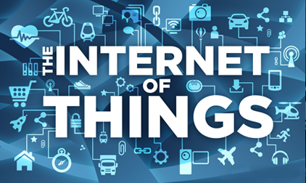
IOT Based Home Security Automation

Slide 2
Presented By
Najam Ud Din Saqib | 02-ITE-2014
Samir Ahmad Malik | 08-ITE-2014
Sarmad Nazki | 09-ITE-2014
Syed Tawseef | 16-ITE-2014
Kumail Abbas | 49-ITE-2013
Under the guidance of Mr. Vishal Sharma

Slide 3
CONTENTS
Introduction.
Applications.
Home Security Automation.
Objectives.
Tools.
Technologies.
Advantages.

Slide 4
INTRODUCTION:
Internet of Things (IoT) is an ecosystem of connected physical objects that are accessible through the internet.
Introduction to Home Automation: To control the home appliances with Smart phone or web browser.Programming electronic devices to respond automatically to certain conditions or scenarios.

Slide 5
Applications of Home Automation:
LIGHTING.
HVAC.
MAINTENANCE.
SAFETY AND SECURITY.
COSTS.

Slide 6

WHY HOME SECURITY AUTOMATION ????
Reference: Google.com

Slide 7
Protecting against the many dangers that can happen in and around the home.
Safeguard home from intruders ,burglars and fire damage.
Security systems can be set to alert in case of freeze or flood.

Slide 8
OBJECTIVES:
The main aim is to provide better security system than the present level of security in the home.
This system is a low cost, flexible home control and monitoring system.
The system captures information and transmits the live video streams via Wi-Fi module to a Smart phone personal application by using web.
This system operates and controls motion detectors.

Slide 9
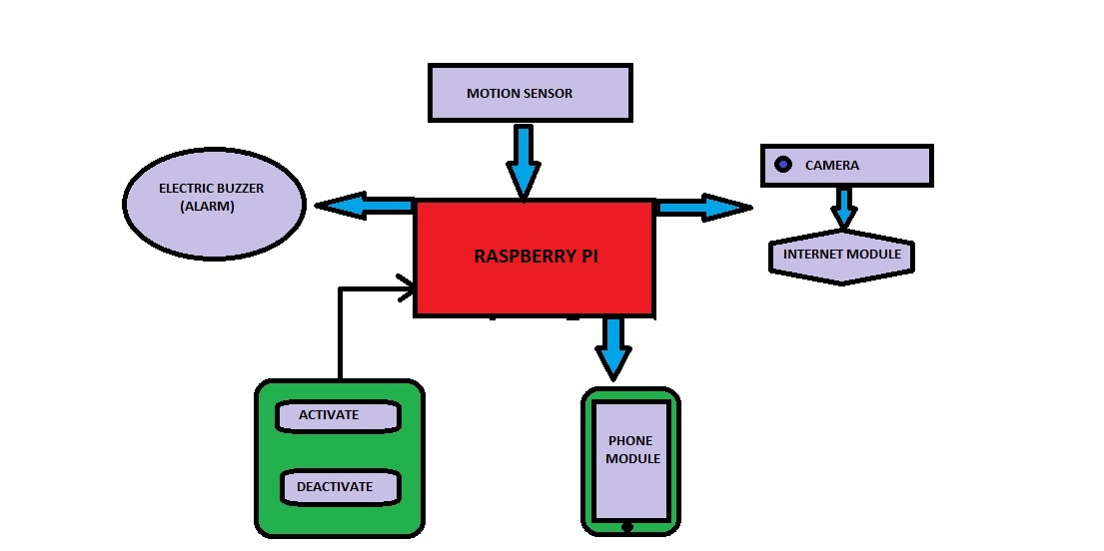
Block Diagram

Slide 10
Tools :
RASPBERRY PI.
RASPBERRY PI CAMERA.
PIR SENSOR.
BUZZER.
PUSH BUTTON.
LED.
CONNECTING WIRES.

Slide 11
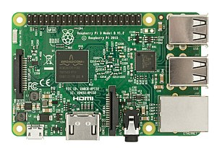
RASPBERRY PI :
The Raspberry Pi is a series of small single-board computers developed in the United Kingdom by the Raspberry Pi Foundation.
Specifications:
Processor speed = 700MHz-1.2GHz
Memory=256MB-1GB
USB ports=4
Reference: Google.com

Slide 12
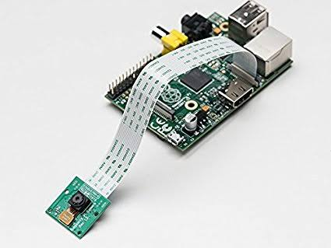
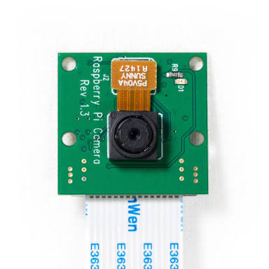
RASPBERRY PI CAMERA:
The camera module can be used to take high definition videos , as well as still photographs.
Specifications:
Still resolution=5 megapixels and 8 megapixels.
Video modes=1080p,720p and 480p.
Reference: Google.com

Slide 13
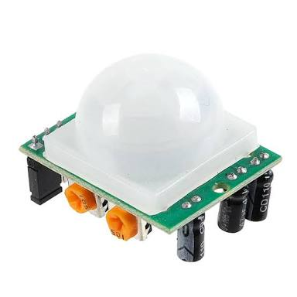
PIR SENSOR :
A passive infrared sensor(PIR sensor) is an electric sensor that measures infrared(IR) light radiating from objects in its field of view.
They are most often used in motion detection.
Specifications:
Sensitivity range= upto 20 feet.
Power supply=5V-12V.
Reference: Google.com

Slide 14
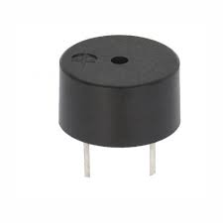
Buzzer:
A buzzer or beeper is an audio signalling device, which may be mechanical, electromechanical, or piezoelectric . Typical uses of buzzers and beepers include alarm devices, timers.
Reference: Google.com

Slide 15
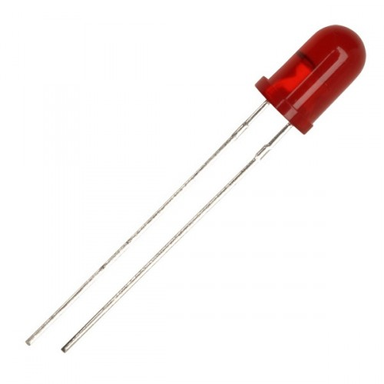
LED:
A light-emitting diode (LED) is a two-lead semiconductor light source. It is a p–n junction diode that emits light when activated.
Reference: Google.com

Slide 16
TECHNOLOGIES:
PYTHON.
DJANGO.

Slide 17
PYTHON:
Python is a general-purpose interpreted, interactive, object-oriented, and high-level programming language. It was created by Guido van Rossum during 1985- 1990. Python source code is available under the GNU General Public License (GPL).

Slide 18
DJANGO:
Django is a free and open-source web framework, written in Python, which follows the model-view-template (MVT) architectural pattern . It is maintained by the Django Software Foundation (DSF).
Django's primary goal is to ease the creation of complex, database-driven websites.

Slide 19
APPLICATIONS:
LIVE VIDEO STREAMING.
E-MAIL ALERT.
MOTION SENSING.
ALARM SYSTEM.

Slide 20
Advantages:
Security.
Savings.
Convenience.
Comfort.
Peace Of Mind.

Slide 21
THANK YOU

